Slide 1
AI and Data Science Bootcamp (Day 1)
Paul Yoo
Dept. CSIS
Birkbeck College
University of London, UK
<number>
Notes:
<number>

Slide 2
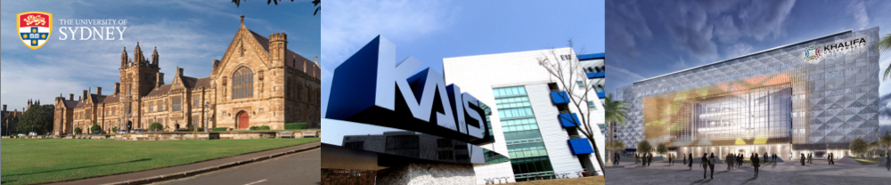
Myself…
Deputy Director for Birkbeck Institute for Data Analytics
Chair for BIDA Threat Intelligence Lab
Visiting Professor at USyd, KAIST and EBTIC
Assoc. Editor for
ACM Computing Surveys
IEEE Transactions on Sustainable Computing
IEEE Access
<number>

Slide 3
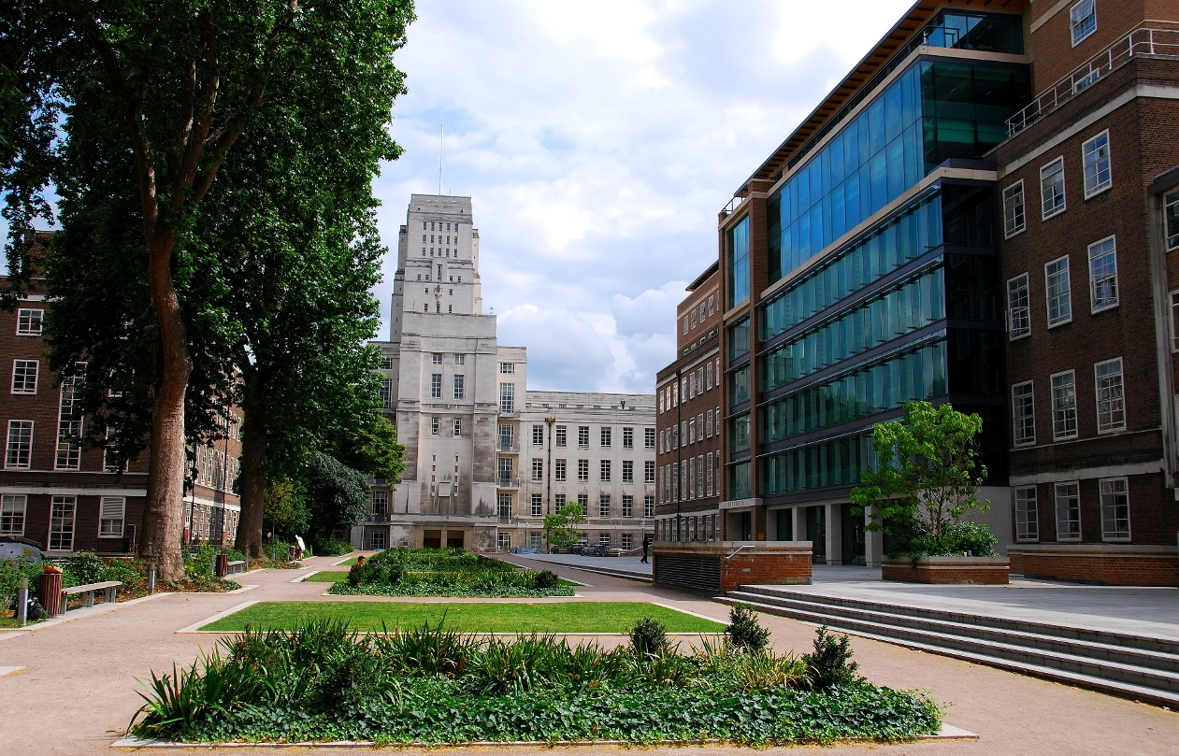
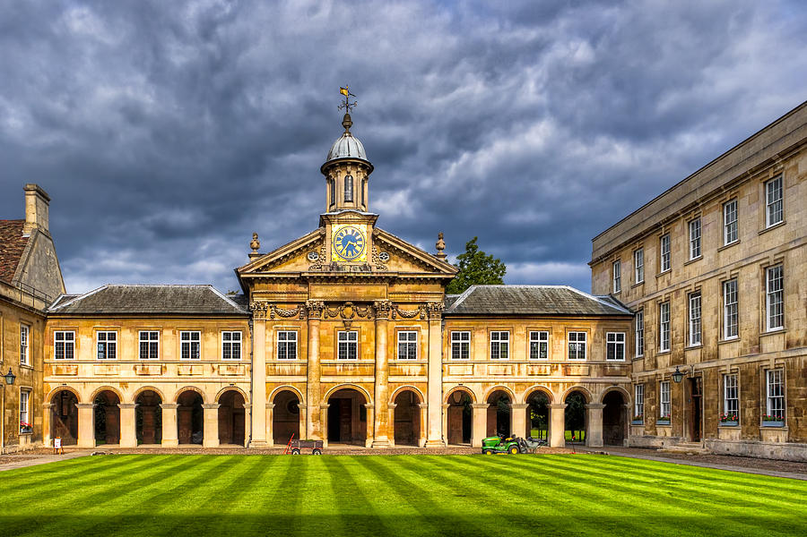
Bernard Fromson
MRes in CS, Birkbeck, University of London (Distinction)
BSc (1st in Med and CS), University of Cambridge
Various work experiences in medicine, finance and computer science.
<number>
Notes:
Bernard recently completed an MRes in Computer Science at Birkbeck, receiving a distinction for his work in applying neural networks to medical imaging problems. He now acts as a teaching assistant at Birkbeck and as technical consultant to a number of companies.
Having initially graduated from University of Cambridge in 1980 with a first in Medicine and Computer science, Bernard spent a short time practicing medicine before moving into finance and spending 35 years managing teams in analytic and modelling roles in various institutions in the City of London.
<number>

Slide 4
Schedule
Day 1 (90 mins)
Real-life Scenario - Smart Grid (PY)
Regressions (PY)
Lab (BF): jupyter lab intro, vector manipulation in python and numpy, regression and logistic regression
Day 2 (90 mins)
Neural Network (MLP) (PY)
Lab (BF): simple neural net, tensorflow/keras specification of a model, simple problem to solve ?mnist using dense layers only
Day 3 (90 mins) by BF
Deep Learning Challenges
Lab: intro to convolutions, develop to CNN, mnist using CNN - discuss complex network and problems
4
Notes:
<number>

Slide 5
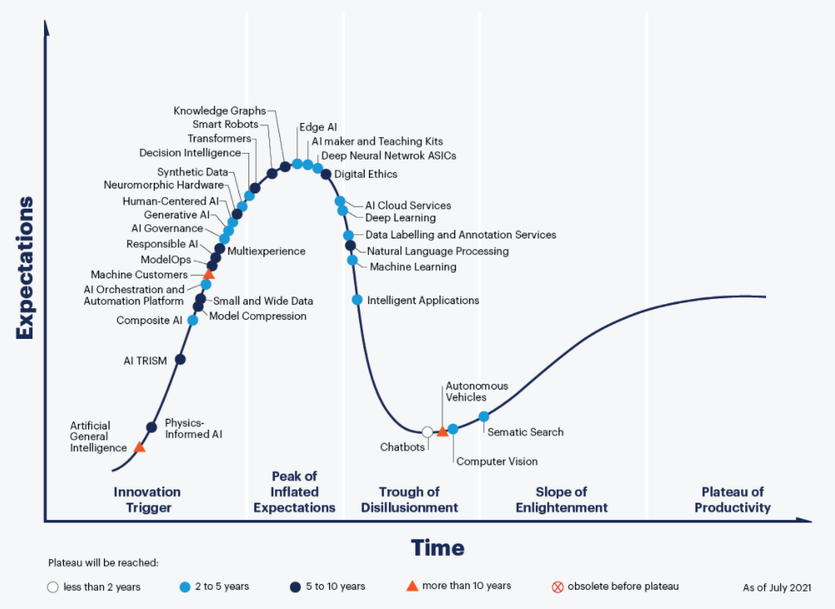
Gartner Hype Cycle 2021

Slide 6
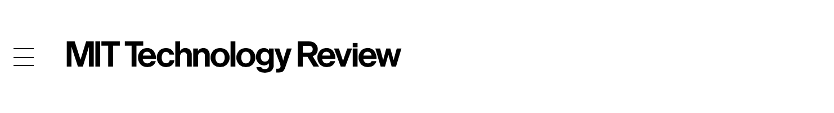
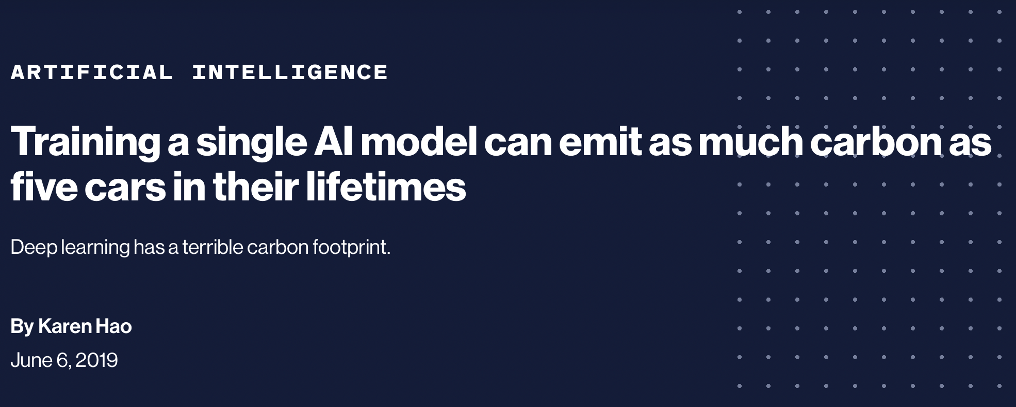
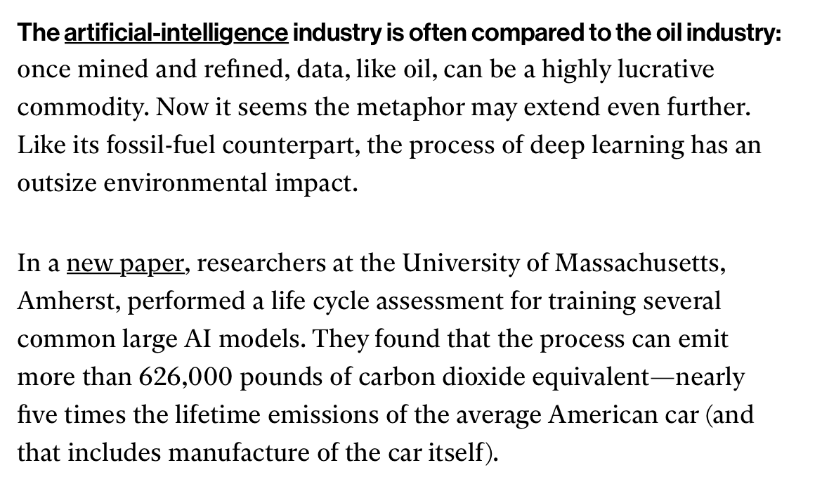

Slide 7
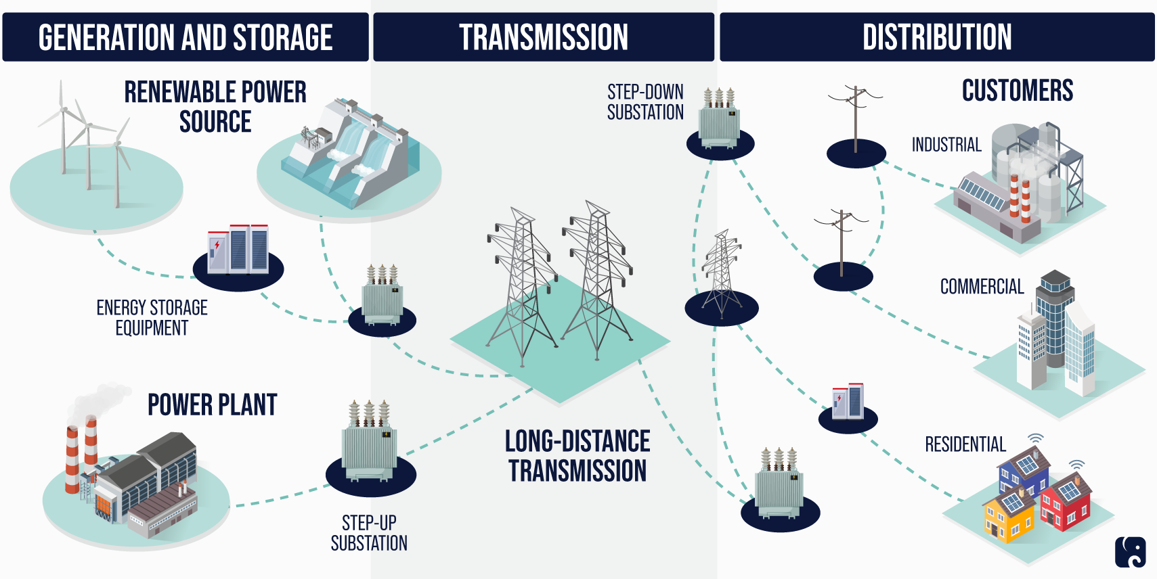
Key Electric Grid Components
[Source] https://www.rpc.senate.gov/policy-papers/infrastructure-cybersecurity-the-us-electric-grid
<number>
Notes:
<number>

Slide 8
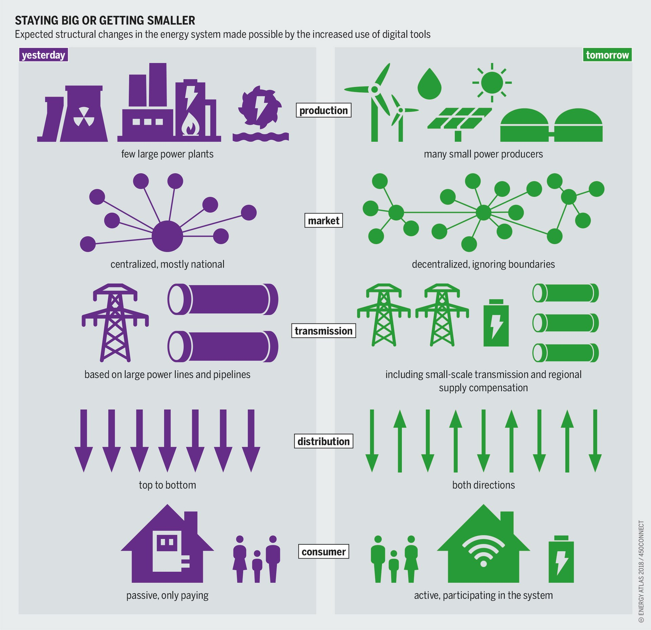
Notes:
<number>

Slide 9
Data-driven Approaches
Big Data (analytics)
“methods for analyzing massive volumes ( > petabytes) of mixed format data that are difficult to process using traditional databases and software techniques”
Machine Learning
“a branch of artificial intelligence based on the idea that systems can learn from data, identify patterns and make decisions with minimal human intervention”
[Source] Kiyoyuki & Terakura (Guest Editors), Sci. Technol. Adv. Mater., 18, 1 (2017).
<number>
Notes:
<number>

Slide 10
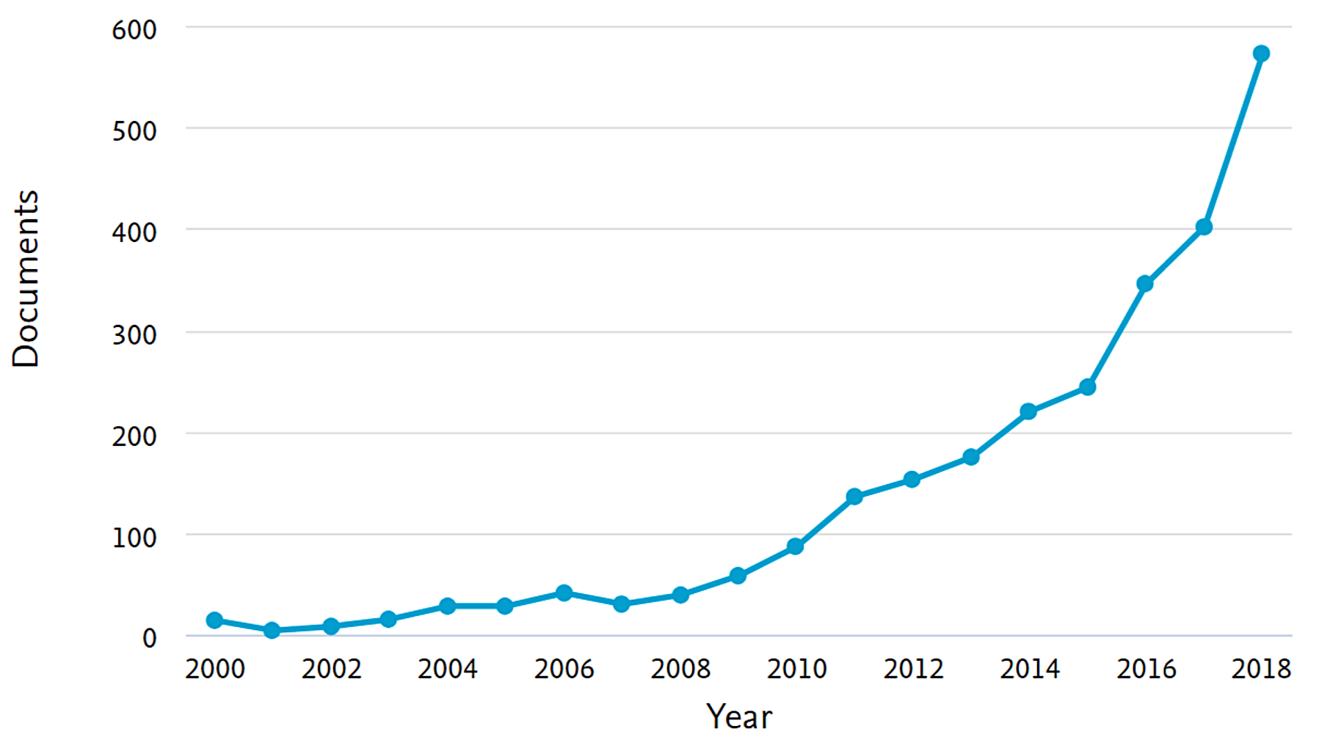
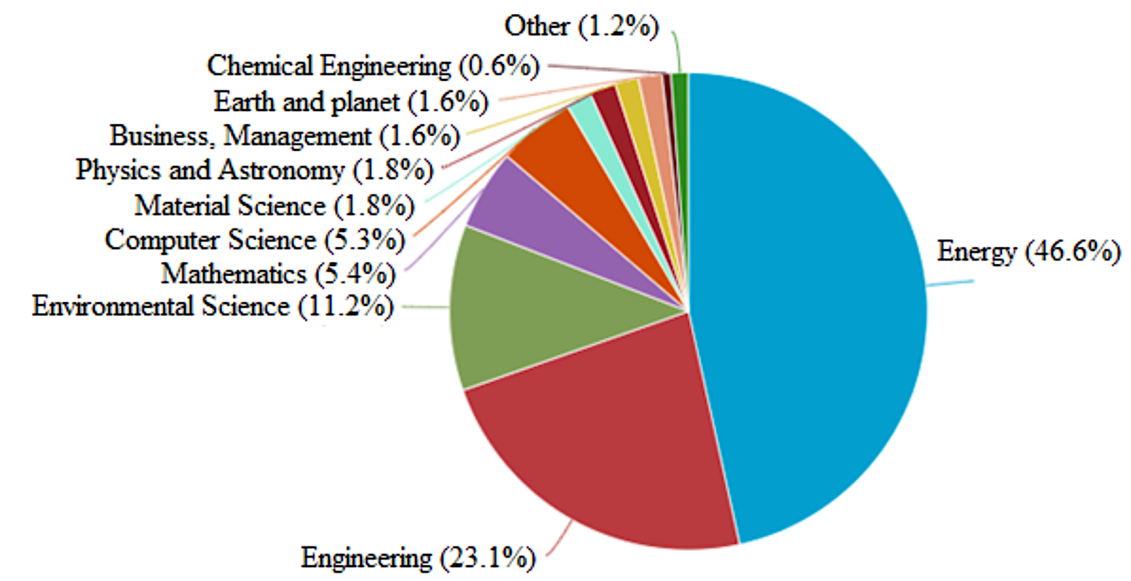
Numbers
The growth in the number of ML articles in energy systems over the past two decades.
Subject areas of ML in energy systems.
[Source] Mosavi, A., Salimi, M., Faizollahzadeh Ardabili, S., Rabczuk, T., Shamshirband, S. and Varkonyi-Koczy, A.R., 2019. State of the art of machine learning models in energy systems, a systematic review. Energies, 12(7), p.1301.
<number>
Notes:
<number>

Slide 11
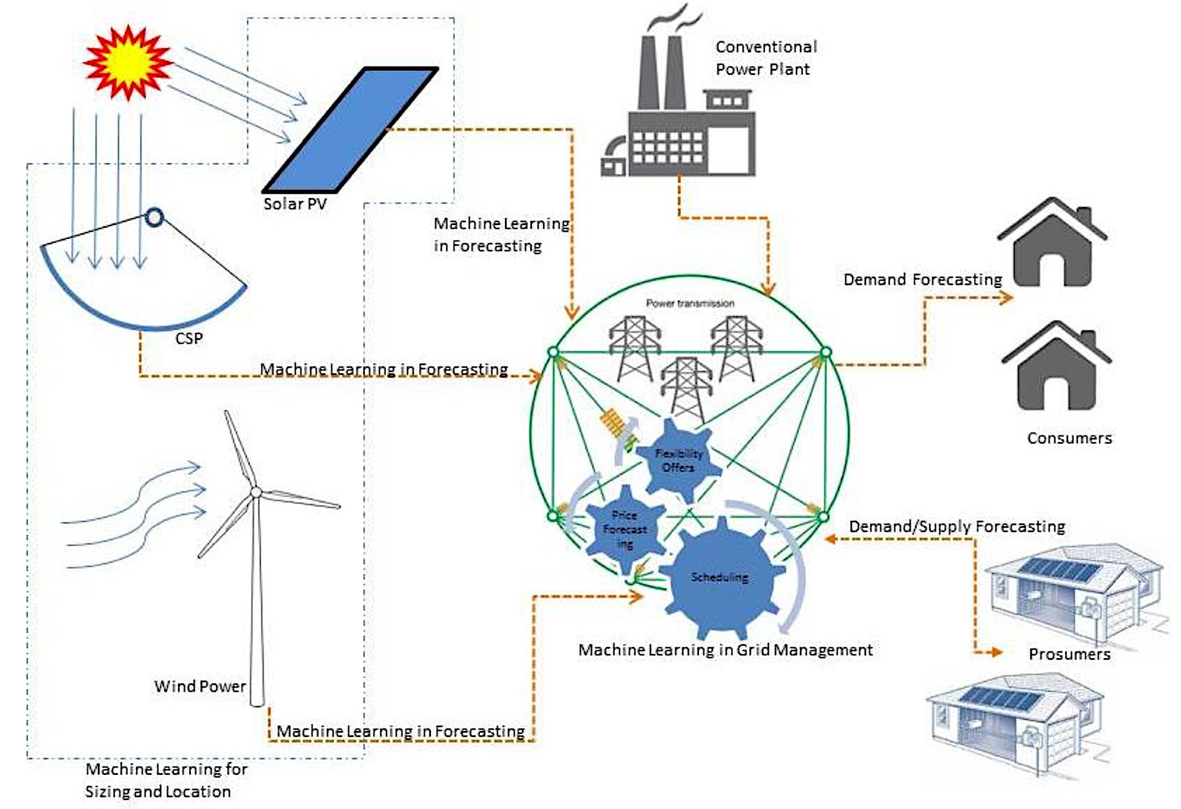
Success Stories
Supporting Renewable Energy Generation and Integration
Traditional research focused on mix of energy sources with a higher percentage of renewable energy sources.
Power generation is dependent on environmental parameters.
Forecasting the amount of power that will be generated in the future is of great importance.
Overview of power grid with integrated renewable sources and its usage of ML techniques in different areas.
[Source] Mosavi, A., Salimi, M., Faizollahzadeh Ardabili, S., Rabczuk, T., Shamshirband, S. and Varkonyi-Koczy, A.R., 2019. State of the art of machine learning models in energy systems, a systematic review. Energies, 12(7), p.1301.
11
Notes:
<number>

Slide 12
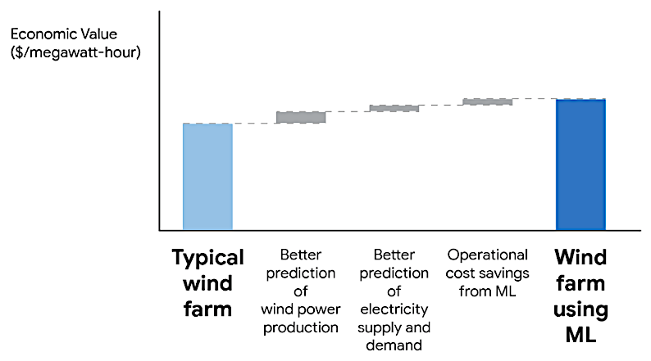
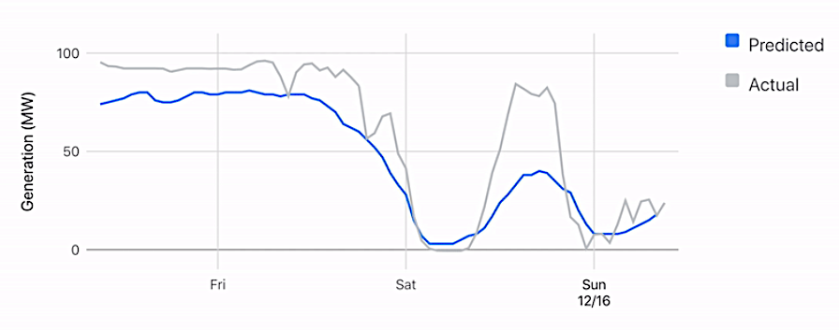
DeepMind Carbon Free Energy Program
ML boosts the values of wind energy.
Successfully predict wind power output 36 hours ahead of actual generation.
A neural network trained on widely available weather forecasts and historical turbine data
Recommend how to make optimal hourly delivery commitments to the power grid a full day in advance
Energy source that can be scheduled are often more valuable to the grid.
Illustrated results from Google/DeepMind field study
[Source] https://www.forbes.com/sites/jeffmcmahon/2020/05/31/thanks-to-renewables-and-machine-learning-google-now-forecasts-the-wind/?sh=25f738d81865
12
Notes:
<number>

Slide 13
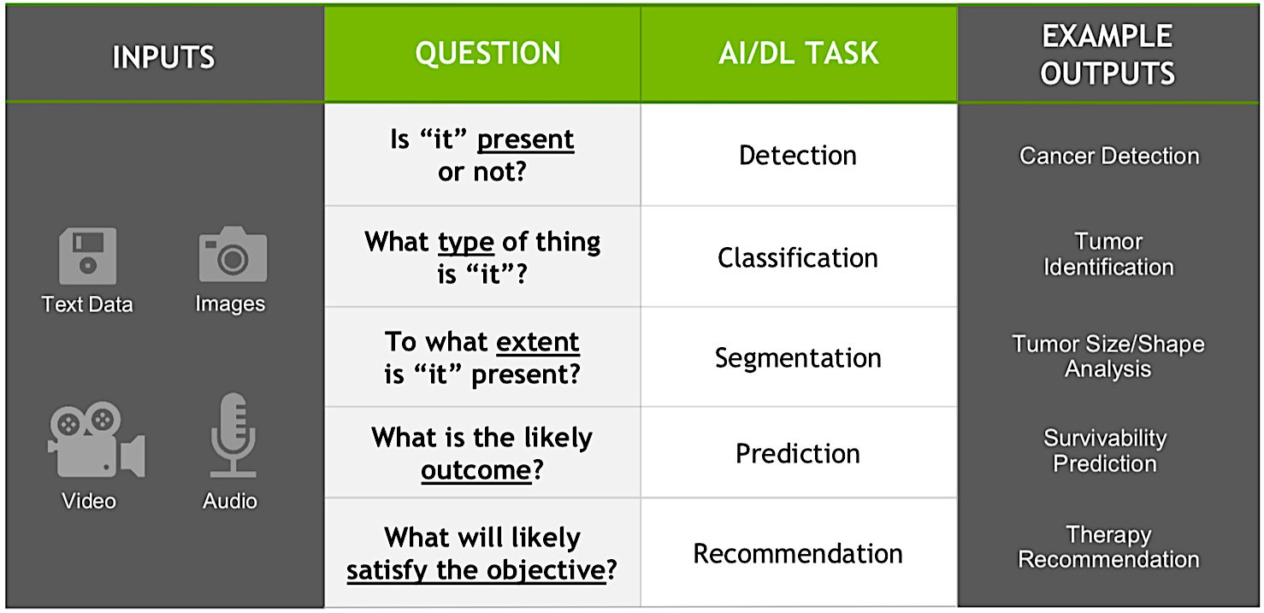
What Problem is ML Solving?
Defining the ML Tasks
Irregular Power Usage
Detection
Power Quality
Classification
Critical Zone
Identification
Power Generation
Prediction
Energy Saving
Recommendation
<number>

Slide 14
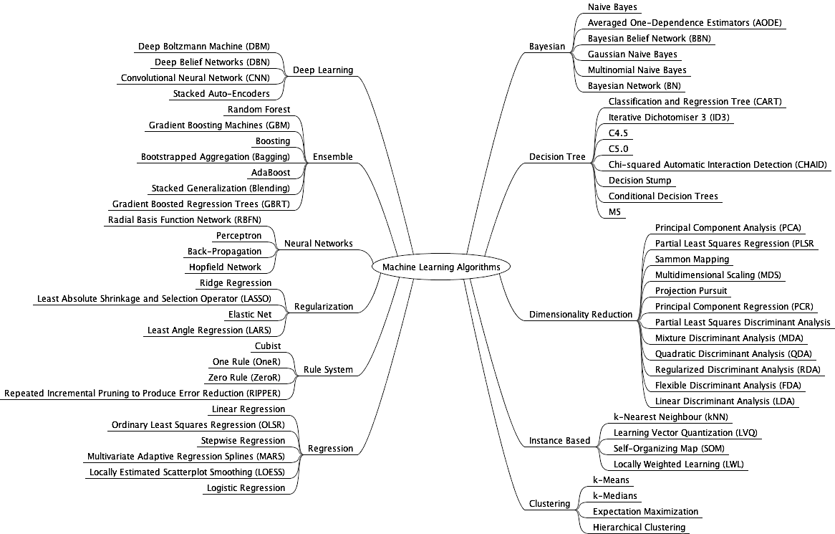
<number>

Slide 15
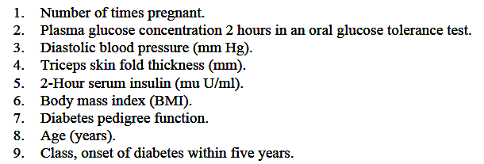
Predictive Modeling Training Data
Training Data
Training data case: categorical or numeric input and target measurements
inputs
target
Examples of categorical variables:
race, sex, age group, educational level etc
Training data : training cases, examples, instances, or records
Variables : inputs, predictors, features, explanatory variables, or independent variables
Targets : response, outcome, or dependent variable
...
Notes:
<number>

Slide 16
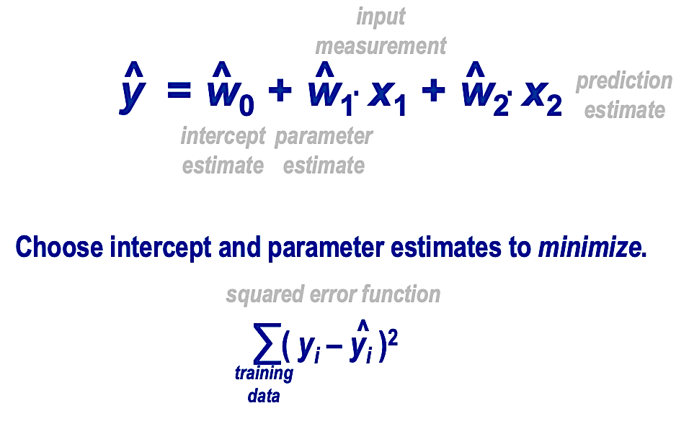
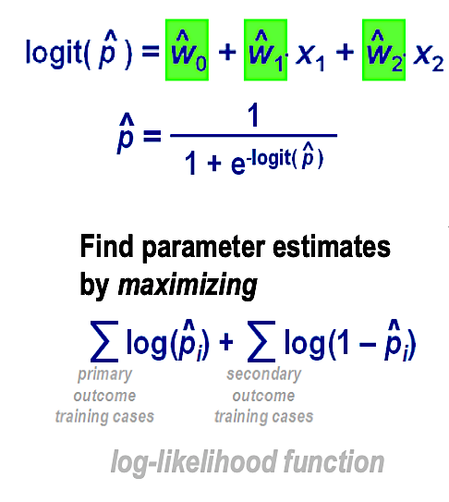
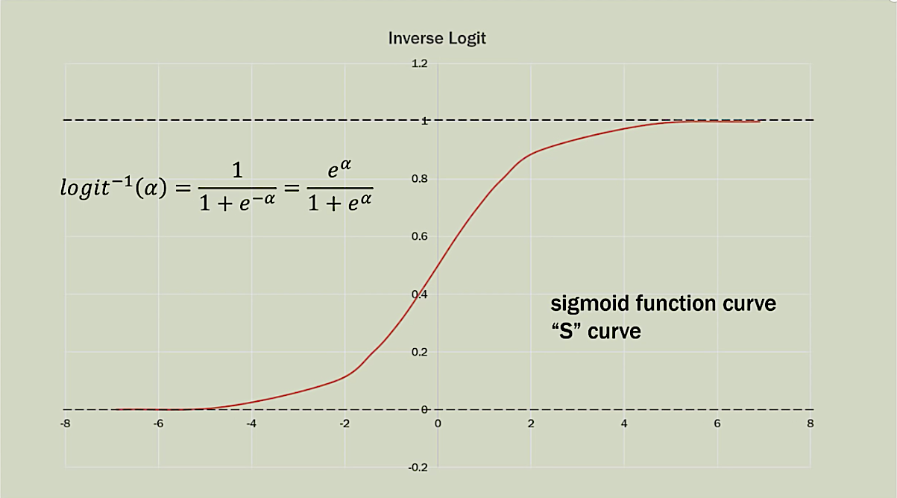
Regression
To obtain prediction estimates, the logit equation is solved for p.
The logistic function is simply the inverse of the logit function.
Notes:
<number>

Slide 17
Guest Account
The user guest account details are
Username: ai-datasci
Password: Pyth0n1c
There is no home folder attached to the account. Users will have to save their work on their personal flash drives.
Python workbooks can be found at https://github.com/bfromson/bbkaids
17
Notes:
<number>

Slide 18
AI and Data Science Bootcamp (Day 2)
Paul Yoo
Dept. CSIS
Birkbeck College
University of London, UK
17
Notes:
<number>

Slide 19
Schedule
Day 1 (90 mins)
Real-life Scenario - Smart Grid (PY)
Regressions (PY)
Lab (BF): jupyter lab intro, vector manipulation in python and numpy, regression and logistic regression
Day 2 (90 mins)
Neural Network (MLP) (PY)
Lab (BF): simple neural net, tensorflow/keras specification of a model, simple problem to solve ?mnist using dense layers only
Day 3 (90 mins) by BF
Deep Learning Challenges
Lab: intro to convolutions, develop to CNN, mnist using CNN - discuss complex network and problems
19
Notes:
<number>

Slide 20
Regression
To obtain prediction estimates, the logit equation is solved for p.
The logistic function is simply the inverse of the logit function.
Notes:
<number>

Slide 21
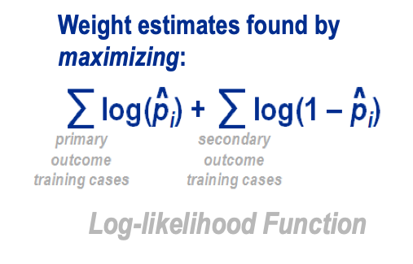
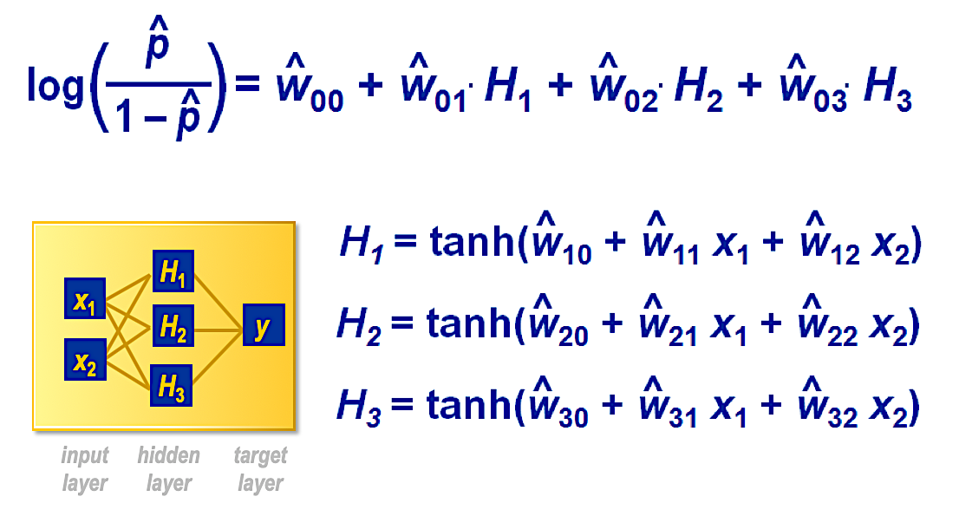
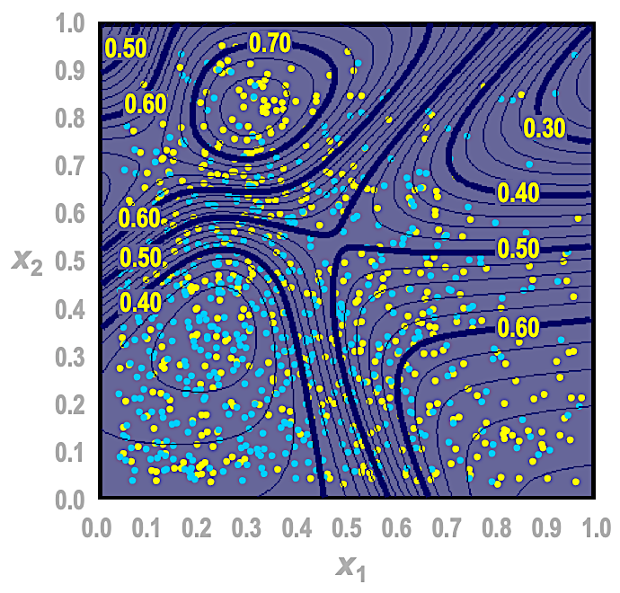
Neural Network
Neural networks can be seen as natural extension of our initial linear regression example.
<number>
Notes:
<number>

Slide 22
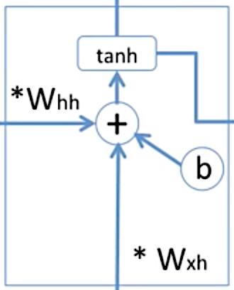
RNN and Sequential Data
Unlike neural networks, RNNs can use their internal state (memory) to process sequences of inputs.
$y_{t}=W_{hy}h_{t}$
$h_{t}=f_{w}\left(h_{t−1},x_{t}\right)$
$h_{t}=tanh\left(W_{hh}h_{t−1}+W_{xh}x_{t}\right)$
$A=achunkofneuralnetwork$
An unrolled recurrent neural network.
The and is the input for the next step.
Similarly, from the next is the input with for the next step and so on.
This way, it keeps remembering the context while training.
** the same function and the same set of parameters are used at every time step
<number>
Notes:
<number>

Slide 23
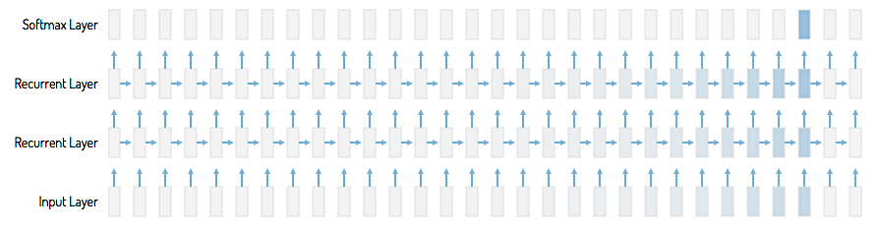
$x_{n}=W_{n}x_{0}$
$x_{i},W∈ℝ$
$x_{i}∈ℝD$
RNN continued
$i∈\left[0,n\right]$
^{xD}
$W_{n}x_{0}→\left\{\begin{matrix}∞; & W>1 \\ 0; & W<1\end{matrix}\right.$
$x_{0}$
Vanishing gradient: Where the contribution from the earlier steps becomes insignificant.
$x_{n}$
This arrow means that long-term information has to sequentially travel through all cells before getting to the current processing cell.
This means it can be easily corrupted by being multiplied many time by small numbers < 0. This is the cause of vanishing gradients.
<number>
Notes:
<number>

Slide 24
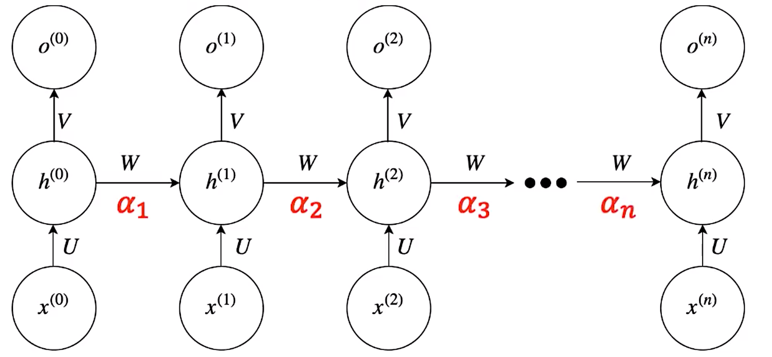
Gated RNN
LSTM is the most commonly used Gated RNN, capable of learning long-term dependencies.
regulates the amount of information the network remembers over time.
LSTM adds another connection from every cell called , the cell state.
Notes:
<number>

Slide 25
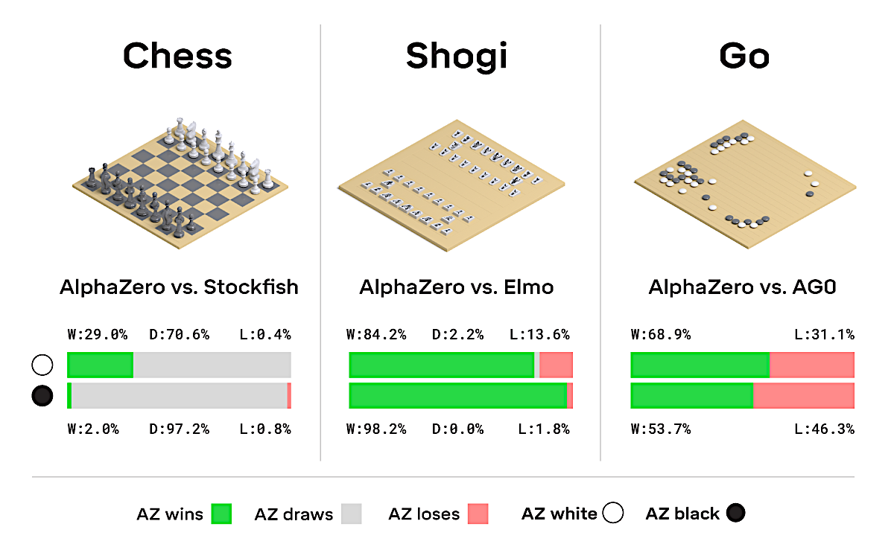
Google DeepMind
AlphaZero taught itself to play three different games
AlphaGo Vs Lee Sedol
AlphaZero
[Source] https://deepmind.com/blog/alphazero-shedding-new-light-grand-games-chess-shogi-and-go/
24

Slide 26
Google DeepMind continues
“Reinforcement learning is concerned with the problem of finding suitable actions to take in a given situation in order to maximize a reward.”
Run?
(convolutional) neural network
Jump
?
Input image
Possible Actions
<number>
Notes:
<number>

Slide 27
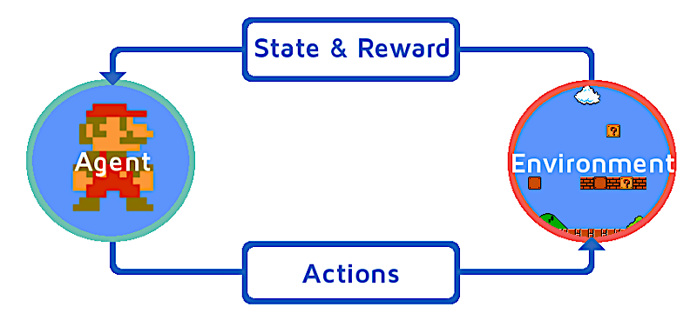
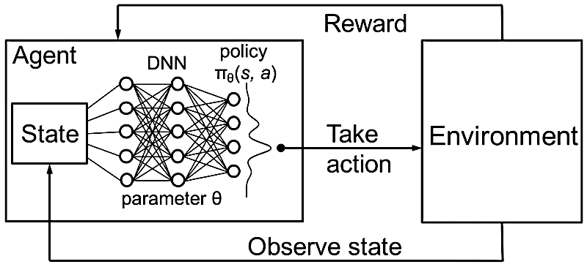
Google DeepMind continued
Could a tool like AlphaZero, based on reinforcement learning who no prior input apart from rules of game, ‘capture’ energy supply and demand feature? ‘choose’ behaviour to optimise power flow?
<number>
Notes:
<number>

Slide 28
Exercise
Modify the code to use separate train and test subsets
<number>
Notes:
<number>

Slide 29
AI and Data Science Bootcamp (Day 3)
Bernard Fromson
MRes Graduate,
Birkbeck College
University of London, UK
<number>
Notes:
<number>

Slide 30
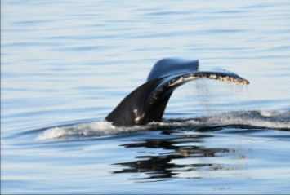

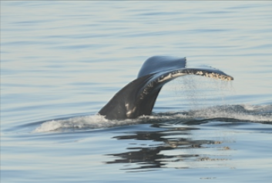
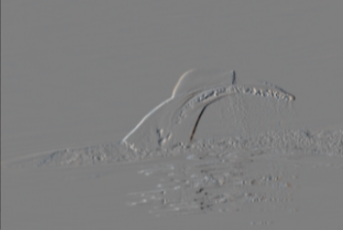
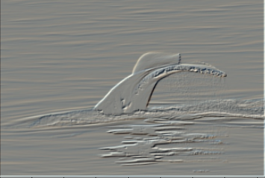
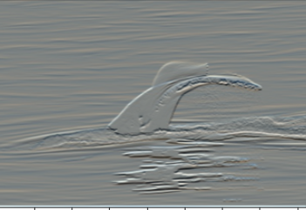
CNN – Convolutional Neural Networks
We all use convolutions almost every day!
Every time you apply a filter to a picture its a convolution
Blurred
Sharpenned
Original Image
Embossed
Horizontal Edges
Vertical Edges
<number>
Notes:
<number>

Slide 31
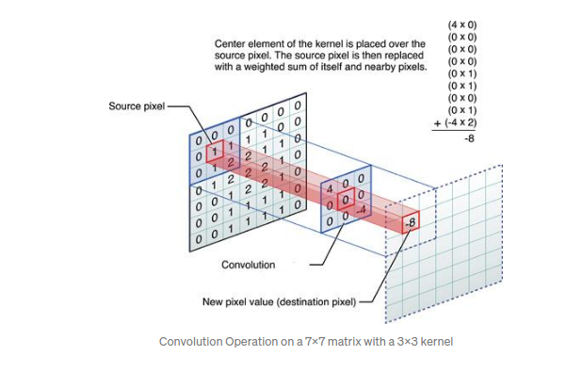
What is a Convolution
Multiply and image by a mask to extract features
Padding and Skipping
Output image will be smaller than the input due to mask not having inputs at edges, overcome by padding
If mask is moved more than one pixel at a time a smaller image is produced due to skipping
<number>
Notes:
<number>

Slide 32
CNN – Convolutional Pre-processing
Yesterday Paul introduced neural nets:
The inputs to this network are arrays of features, X1 and X2
But what if we start with an image as the input?
- Each pixel of image as an input feature?
- Or pre-process the image
<number>
Notes:
<number>

Slide 33
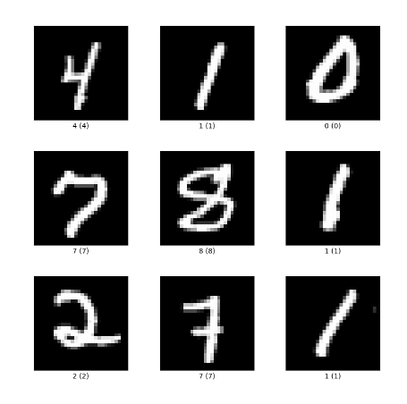
CNN – MNIST
Recognising hand written numbers – it’s the “Hello World” of image processing!
Each number 28 * 28 black and white image
784 input features of pixels
But most are plain black, so it’s wasting inputs
So instead let’s pre-process the images
<number>
Notes:
<number>

Slide 34
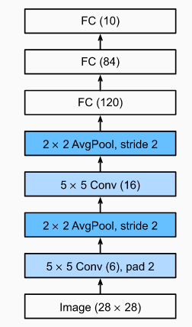
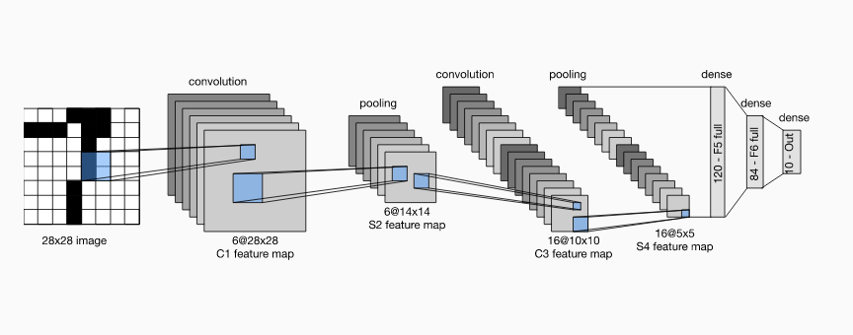
CNN – Simple “Deep” Network - LeNet-5
LeNet-5 Architecture Diagram and Simplified Notation
Use convolutions to extract features, then pool them together for smaller images.
Repeat that process
Then flatten results into classical neural net
<number>
Notes:
<number>

Slide 35
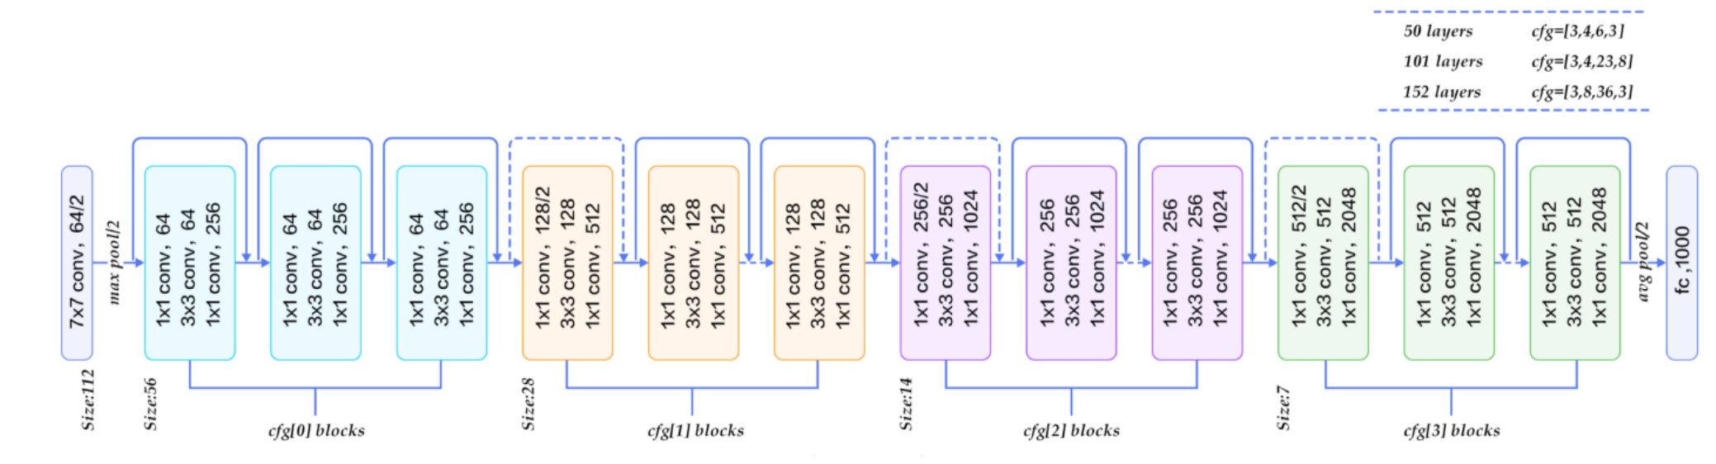
CNN – Developments
LeNet5 was introduced by Yan LeCun et al in 1989
Then - SUN Sparc 10 workstation – 2 weeks to train
Now – GPU accelerators, Nvidia 2080 Ti – 20 seconds!!!!
More complex and deeper networks with skip connections to preserve gradients
<number>
Notes:
<number>

Slide 36
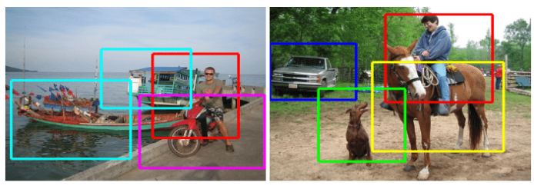
CNN – Multi Label Image Recognition
From recognising one handwritten letter to:
<number>
Notes:
<number>

Slide 37
CNN – Practical Implementation
Tensorflow and Keras now give us a high level language where a model can be easily specified.
LeNet5 can be coded in 10 lines (2 of which are dropouts) !
model = keras.Sequential()
model.add(Conv2D(32, kernel_size=(5, 5), strides=(1, 1), padding='same',activation='relu', input_shape=input_shape))
model.add(MaxPooling2D(pool_size=(2, 2), strides=(2, 2)))
model.add(Conv2D(64, (5, 5), activation='relu', padding='same'))
model.add(MaxPooling2D(pool_size=(2, 2)))
model.add(Dropout(0.25))
model.add(Flatten())
model.add(Dense(1000, activation='relu'))
model.add(Dropout(0.5))
model.add(Dense(num_classes, activation='softmax'))
<number>
Notes:
<number>

Slide 38
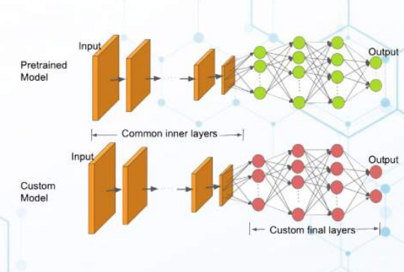
CNN – Transfer Learning
Take a complex model that has been trained on a standard dataset and preserve its weights but just add an extra trainable layer to train for another dataset.
resnet_model = Sequential()
pretrained_model= tf.keras.applications.ResNet50(include_top=False,
input_shape=(180,180,3),
pooling='avg',classes=5,
weights='imagenet')
for layer in pretrained_model.layers:
layer.trainable=False
resnet_model.add(pretrained_model)
resnet_model.add(Flatten())
resnet_model.add(Dense(512, activation='relu'))
resnet_model.add(Dense(5, activation='softmax'))
11 lines to generate a full deep network
<number>
Notes:
<number>

Slide 39
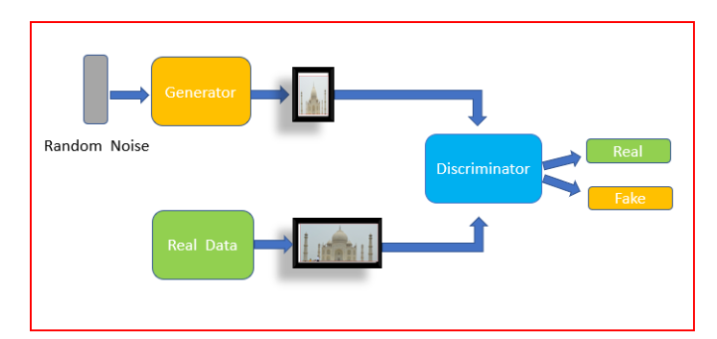
GAN – Generative Adversarial Network
Build a model that can mimic another dataset
Use output from discriminator to feedback to generator and improve model until discriminator cannot distinguish between real and fake
<number>
Notes:
<number>

Slide 40
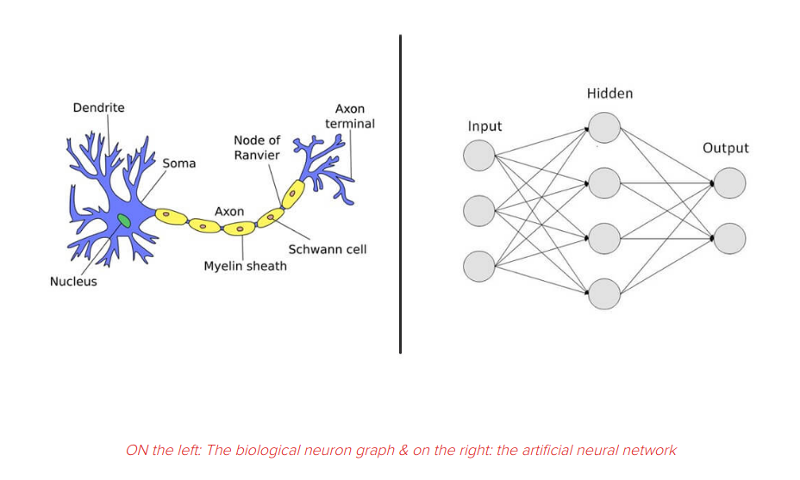
Challenges ahead ...
Neural networks are meant to mimic actions of neurons on the brain
Each node in the network receives multiple inputs and passes its output to multiple nodes at next level – a process that was meant to replicate the action of neurons
Source: https://clevertap.com/blog/neural-networks/
<number>
Notes:
<number>

Slide 41
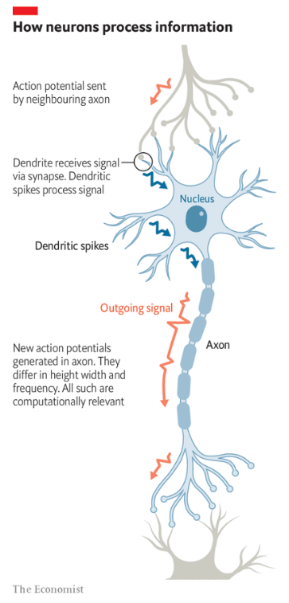
Challenges ahead ...
Latest research suggests much more complex processing happens within a single neuron and that the output is more variable.
Individual dendrites interact with the incoming signal and can process it as it is passed to the nucleus.
Output along the axon is not a single value but a signal with varying frequency and intensity.
There is still plenty of room for research to improve current network implementations!
(see article in the Economist, 29-June-2022, “How neurons really work is being elucidated”)
<number>
Notes:
<number>

Slide 42
Questions?
bhfromson@gmail.com
<number>
Notes:
<number>

